Slide 1
MORTALITY RATE ANALYSIS Examining the connection between mortality rate, pollution, and socioeconomic variables

Slide 2
TABLE OF CONTENTS
Introduction
Executive Summary
Diagnostic Data
Model Selection Process
Final Model
Next Steps

Slide 3
INTRODUCTION
Pollution dataset found on Carnegie Mellon library website at http://lib.stat.cmu.edu/datasets/pollution
The dataset contains 16 variables, including both pollution, weather, and socioeconomic variables for 60 cities in the US in 1960
Ex: Precipitation, Humidity, January Temperature, Years of Education, Poverty Rate etc
The goal is to analyze and find the predictors that best explain the age adjusted mortality rate per 100,000, and then use these predictors to prompt a policy analysis or discussion on how to lower the mortality rate in certain American cities

Slide 4
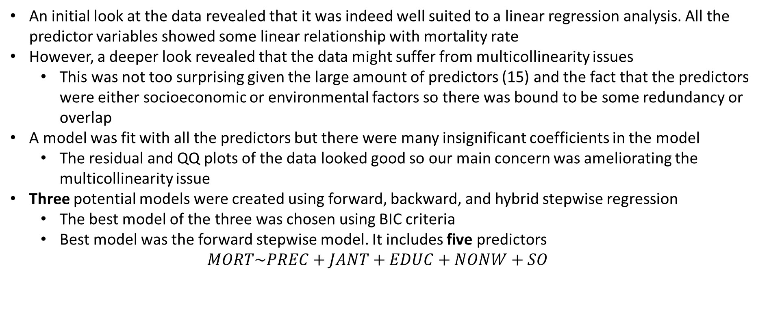
EXECUTIVE SUMMARY
An initial look at the data revealed that it was indeed well suited to a linear regression analysis. All the predictor variables showed some linear relationship with mortality rate
However, a deeper look revealed that the data might suffer from multicollinearity issues
This was not too surprising given the large amount of predictors (15) and the fact that the predictors were either socioeconomic or environmental factors so there was bound to be some redundancy or overlap
A model was fit with all the predictors but there were many insignificant coefficients in the model
The residual and QQ plots of the data looked good so our main concern was ameliorating the multicollinearity issue
Three potential models were created using forward, backward, and hybrid stepwise regression
The best model of the three was chosen using BIC criteria
Best model was the forward stepwise model. It includes five predictors
$$MORT\sim PREC+JANT+EDUC+NONW+SO$$

Slide 5
DATA DIAGNOSTICS

Slide 6
LEGEND
Before going further into the exploratory analysis below is a legend of the dataset so we know what the shorthand names mean
Environmental Predictors
Socioeconomic Predictors

Slide 7
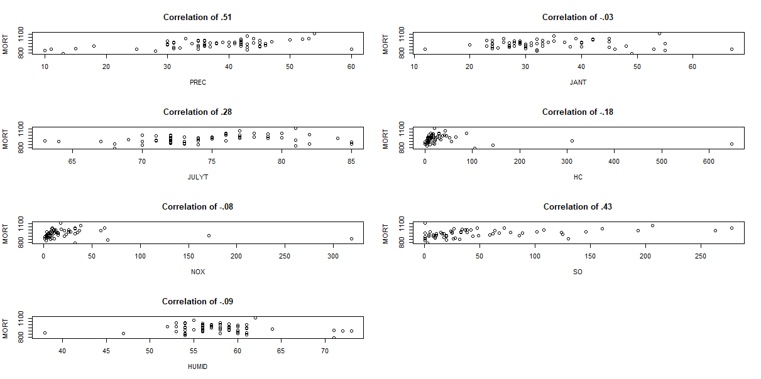
ENVIRONMENTAL FACTORS VS MORTALITY RATE

Slide 8
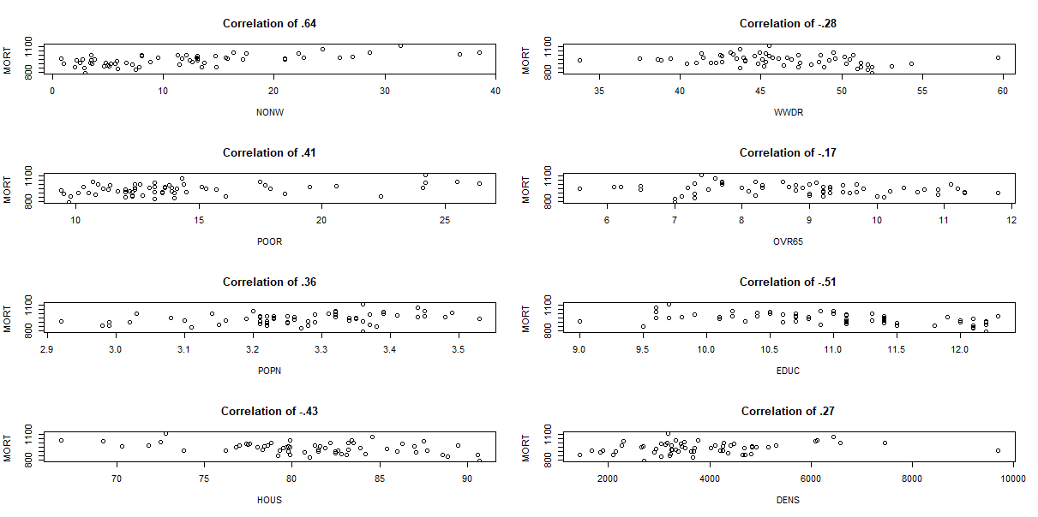
SOCIOECONOMIC FACTORS VS MORTALITY RATE

Slide 9
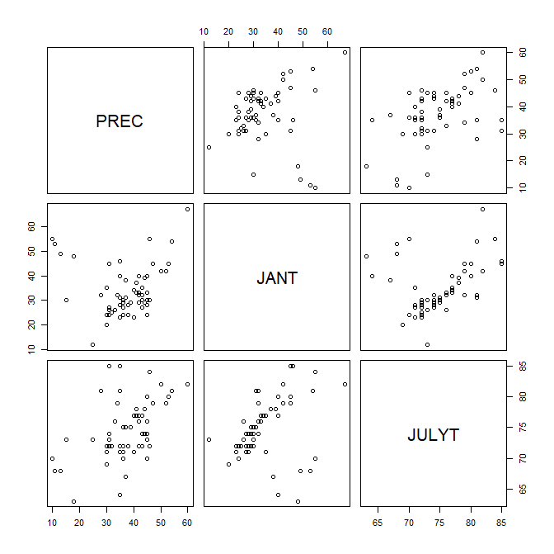
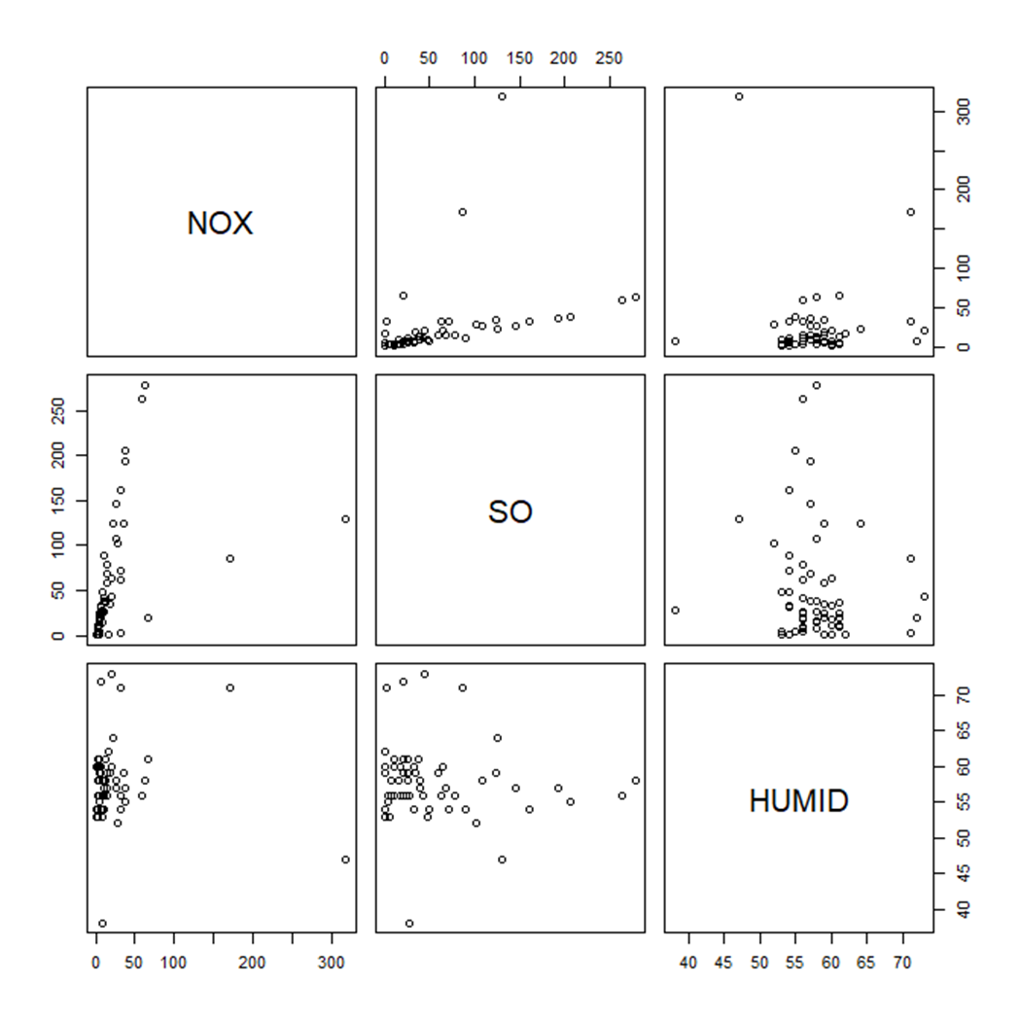
CORRELATIONS AMONGST PREDICTORS
Notes:
Add legend for variable names

Slide 10
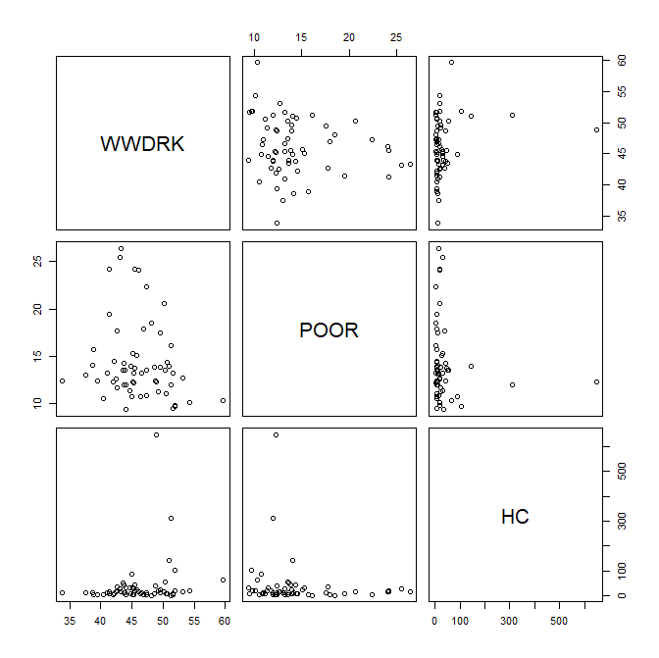
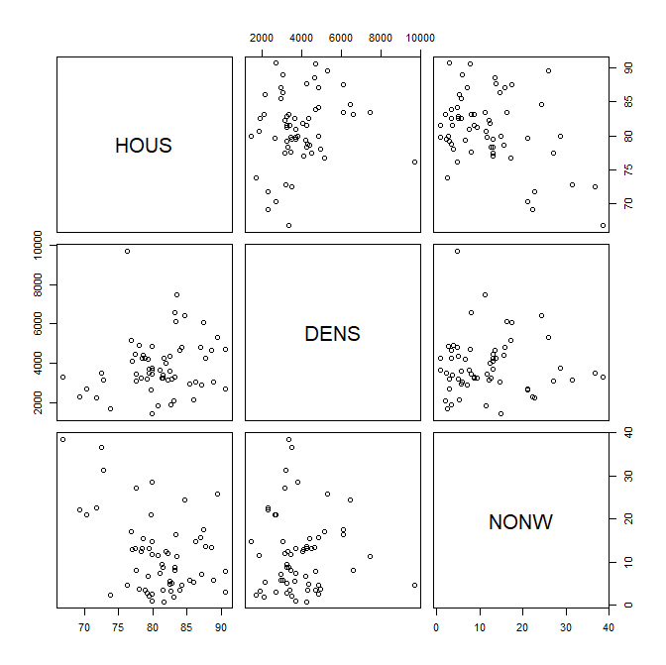
CORRELATIONS AMONGST PREDICTORS
Notes:
Add legend for variable names

Slide 11
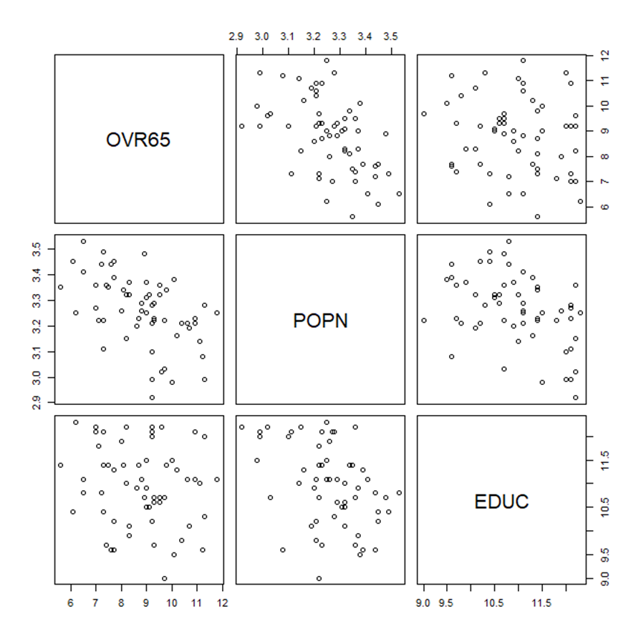
CORRELATIONS AMONGST PREDICTORS
Notes:
Add legend for variable names

Slide 12
CORRELATION MATRIX
 | PREC | JANT | JULYT | OVR65 | POPN | EDUC | HOUS | DENS | NONW | WWDRK | POOR | HC | NOX | SO | HUMID
PREC | 1.00 | 0.09 | 0.50 | 0.10 | 0.26 | -0.49 | -0.49 | 0.00 | 0.41 | -0.30 | 0.51 | -0.53 | -0.49 | -0.11 | -0.08
JANT |  | 1.00 | 0.35 | -0.40 | -0.21 | 0.12 | 0.01 | -0.10 | 0.45 | 0.24 | 0.57 | 0.35 | 0.32 | -0.11 | 0.07
JULYT |  |  | 1.00 | -0.43 | 0.26 | -0.24 | -0.42 | -0.06 | 0.58 | -0.02 | 0.62 | -0.36 | -0.34 | -0.10 | -0.45
OVR65 |  |  |  | 1.00 | -0.51 | -0.14 | 0.07 | 0.16 | -0.64 | -0.12 | -0.31 | -0.02 | 0.00 | 0.02 | 0.11
POPN |  |  |  |  | 1.00 | -0.40 | -0.41 | -0.18 | 0.42 | -0.43 | 0.26 | -0.39 | -0.36 | 0.00 | -0.14
EDUC |  |  |  |  |  | 1.00 | 0.55 | -0.24 | -0.21 | 0.70 | -0.40 | 0.29 | 0.22 | -0.23 | 0.18
HOUS |  |  |  |  |  |  | 1.00 | 0.18 | -0.41 | 0.34 | -0.68 | 0.39 | 0.35 | 0.12 | 0.12
DENS |  |  |  |  |  |  |  | 1.00 | -0.01 | -0.03 | -0.16 | 0.12 | 0.17 | 0.43 | -0.12
NONW |  |  |  |  |  |  |  |  | 1.00 | 0.00 | 0.70 | -0.03 | 0.02 | 0.16 | -0.12
WWDRK |  |  |  |  |  |  |  |  |  | 1.00 | -0.19 | 0.20 | 0.16 | -0.07 | 0.06
POOR |  |  |  |  |  |  |  |  |  |  | 1.00 | -0.13 | -0.10 | -0.10 | -0.15
HC |  |  |  |  |  |  |  |  |  |  |  | 1.00 | 0.98 | 0.28 | -0.02
NOX |  |  |  |  |  |  |  |  |  |  |  |  | 1.00 | 0.41 | -0.05
SO |  |  |  |  |  |  |  |  |  |  |  |  |  | 1.00 | -0.10
HUMID |  |  |  |  |  |  |  |  |  |  |  |  |  |  | 1.00
This chart displays the correlations between the predictors.
The yellow and red colors let us easily see that there might be some correlation issues between predictors
Notes:
Add legend for ρρvariable names

Slide 13
MODEL SELECTION PROCESS

Slide 14
ALL INCLUSIVE MODEL
$$MORT=1764+1.9PREC−1.93JANT−3.1JULYT−9.1OVR65−106.8POPN−17.16EDUC−.65HOUS+.0036DENS+4.46NONW−.187WWDRK−.168POOR−.672HC+1.34NOX+.086SO+.106HUMID$$
The initial model only has 3 significant predictors: PREC, JANT and NONW.
Given the size of the coefficients, the variances of some of the predictors are quite large which indicates multicollinearity.
A second pointer towards multicollinearity is that the F-test is significant despite having many non-significant predictors in the model
The model had a strong fit but this could be due to overfitting and having a large number of predictors included.
Notes:
Add legend for variable names

Slide 15
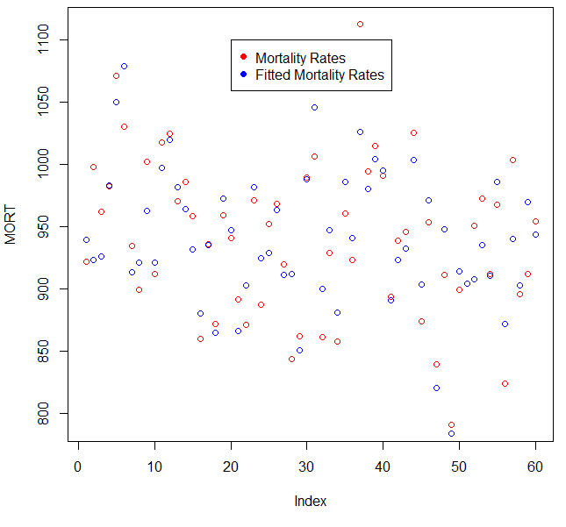
FITTED VS ACTUAL
Notes:
Add legend for variable names

Slide 16
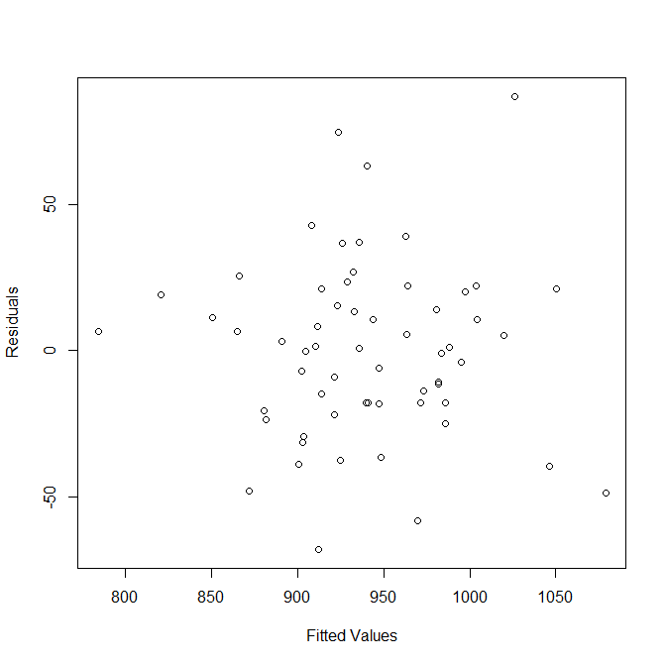
RESIDUAL PLOT
Notes:
Add legend for variable names

Slide 17
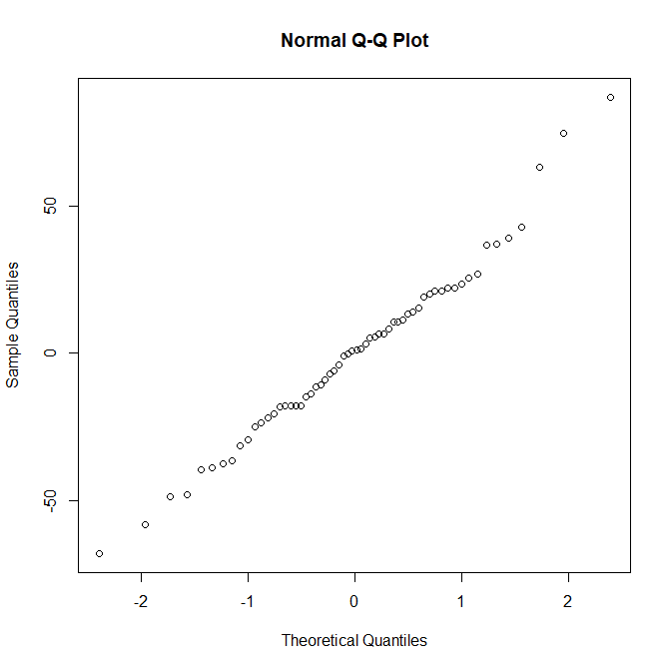
QQ PLOT
Notes:
Add legend for variable names

Slide 18
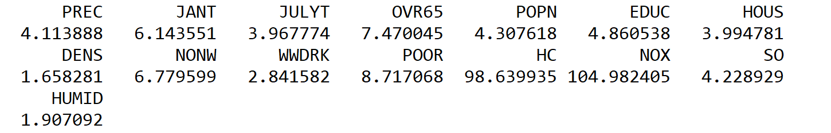
VIF
Variance Inflation Factors
The previous three slides showed the residuals and QQ-plot of our model look normal
The main problem our dataset has is shown on this slide with the high Variance Inflation Factors.
We have two factors with VIFs well above 10 and the average VIF of all the factors is much greater than 1 suggesting that we have a serious multicollinearity problem
Notes:
Add legend for variable names

Slide 19
FORWARD STEPWISE REGRESSION
$$MORT=1016.42+1.49PREC−1.63JANT−12.76EDUC+4.06NONW+.28SO$$
All 5 predictors are significant and the variances aren’t as large compared to the predictor coefficients anymore. Previously, in the full model some of the predictors’ variance were almost as large as the coefficient itself. The variances are much smaller comparatively
Notes:
Add legend for variable names

Slide 20
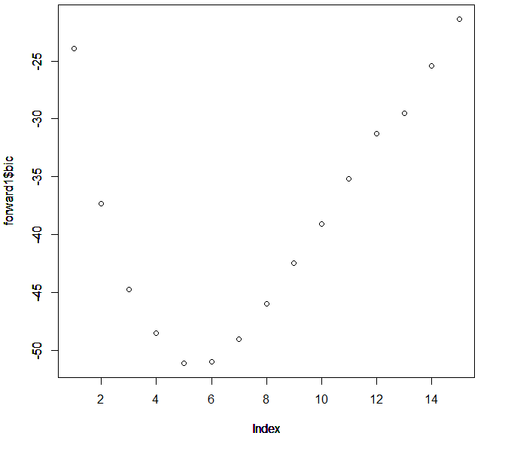
FORWARD STEPWISE REGRESSION
BIC=-51.15134
Notes:
Add legend for variable names

Slide 21
BACKWARDS STEPWISE REGRESSION
$$MORT=1145.2−1.56JANT−19.40EDUC+4.46NONW−.98HC+1.99NOX$$
Like in the forward model, all 5 predictors are significant and the variances are much smaller compared to the predictor coefficients.
The hybrid model selection process generated the same model as the backward process, so it is not discussed further to avoid redundancy.
Notes:
Add legend for variable names

Slide 22
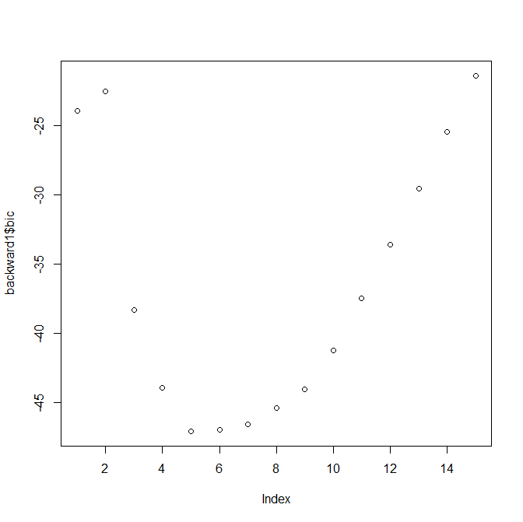
BACKWARD STEPWISE REGRESSION
BIC= -47.11147
Notes:
Add legend for variable names

Slide 23
RECAP
Of our three potential models created by forward, backward, and hybrid stepwise regression only two were unique.
The forward model and backward model
Both models contained 5 variables however:
The forward contained: PREC,JANT, EDUC, NONW, SO
The backward contained: JANT, EDUC, NONW, HC, NOX
The forward regression produced a smaller BIC though and so we will proceed with that model as our best option
Notes:
Add legend for variable names

Slide 24
FINAL MODEL

Slide 25
MODEL
$$MORT=1016.42+1.49PREC−1.63JANT−12.76EDUC+4.06NONW+.28SO$$
Now that we have selected the best model we can interpret its results
It would seem that the higher the median education of an area, the lower the mortality rate
This makes intuitive sense. More educated people probably live in safer areas, and work less dangerous jobs thus having a lower mortality rate
Another insight to come out of the model is that the higher the non-white population in an area is, there is an increased mortality rate.
Lastly, we see some of the weather factors play a role in mortality rate. There is a positive relationship between mortality rate and sulfuric oxide pollution potential as well as precipitation.
Notes:
Add legend for variable names

Slide 26
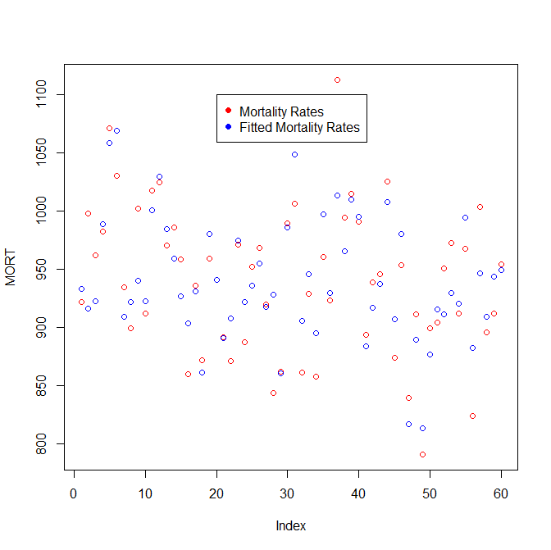
FITTED VS ACTUAL
Notes:
Add legend for variable names

Slide 27
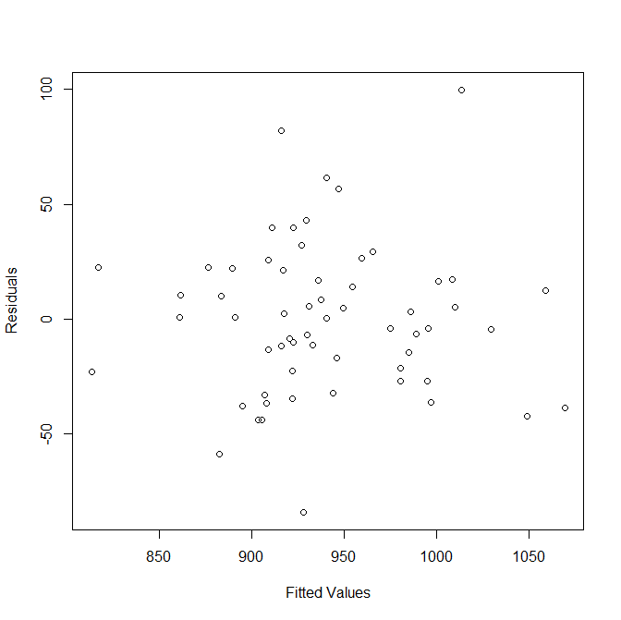
RESIDUALS
Notes:
Add legend for variable names

Slide 28
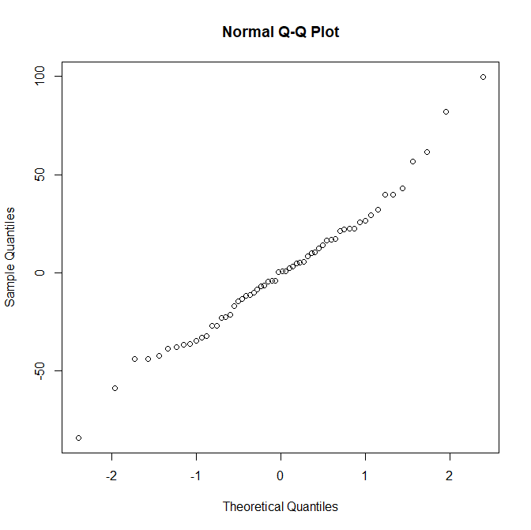
QQ PLOT
Notes:
Add legend for variable names

Slide 29

VIF
VIFs for Forward Model
VIFs for Backward Model
As a final check of our new model we look to see if the Variance Inflation Factors have been corrected. We see in the forward model there are no longer any factors larger than 10 and the average VIF is not much larger than 1
The model produced through the backward stepwise regression still has a significant multicollinearity problem. This further supports our decision to choose the forward stepwise model over the backward stepwise model.
Notes:
Add legend for variable names

Slide 30
NEXT STEPS
The largest insight coming of the data would be that lower educations leads to higher mortality rates.
This would suggest that to improve the quality of life of US citizens educational reform and educational programs should be a priority.
The second insight would be that there is a need to take a deeper look at the issues afflicting urban areas with a large non-white population.
It is likely that these areas suffer from issues not encountered in white urban areas, and not addressed by a lot of public polic.
A targeted study of these areas could lead to more insights and more specific recommendations on how to help those areas.
Notes:
Add legend for variable names

